Slide 1

Relax, it's SPA time Mónica Rodrigues
60ª Reunião Presencial - 19/03/2016
http://netponto.org

Slide 2
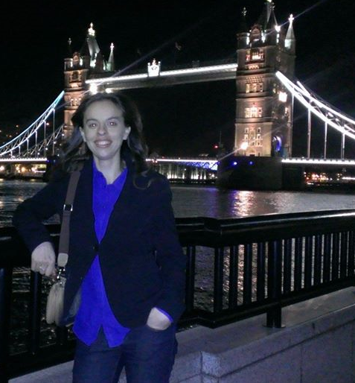



Who I am?
Mónica Rodrigues
Software Engineer
Since 2010: HTML5, CSS3, AngularJs, Knockout,
Asp.Net WebApi, C#
Member and Organizer

Slide 3
Contents
Challenge
Solution
Motivations
Considerations
Multiple page application vs SPA
Some Javascript Frameworks
Demo
References

Slide 4
Challenge
Users want a central place to view or take actions on most or all content so they don’t have to waste time navigating between pages.

Slide 5

Solution
Go to a SPA

Slide 6
Solution
Use modern web development techniques to build a single-page app that doesn’t need to reload itself as the user browses through it.
SPA
Single Page Application

Slide 7
Motivations
Reach
Web app may be accessible on different platforms and devices
Reponsive
Web app needs to be very responsive to different screen resolutions
Round trip
Web app does not require many round trips between client and server

Slide 8
Motivations
Better user experience
Separation of responsibilities between client and server
Offline Applications

Slide 9
Considerations
The first time that the applications loads is slow
Deep linking
SEO (Search engine optimization) is complicated

Slide 10
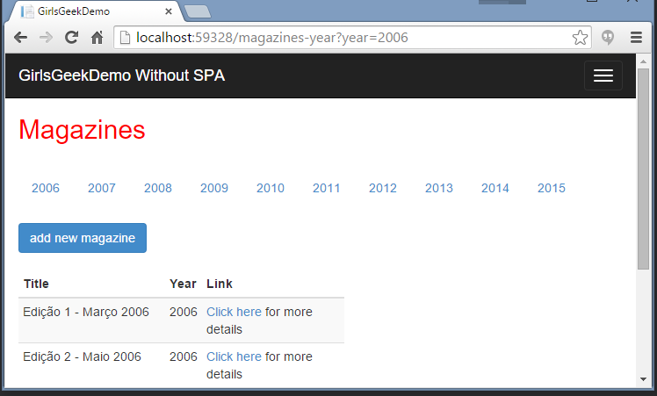

Multiple Page Application
Page access
Page rendering
Returns rendered page

Slide 11
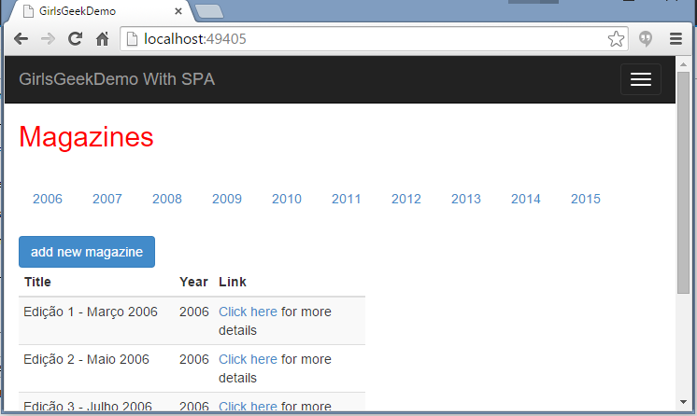
Single Page Application
Requests data
DOM processing and manipulation
Returns data

Slide 12





Some Javascript Frameworks and Libraries

Slide 13







SPA Samples

Slide 14
NetPonto Attendance Manager SPA
demo

Slide 15

Dúvidas?

Slide 16
References
Angular Js
https://angularjs.org/
Knockout
http://knockoutjs.com/
Aurelia
http://aurelia.io/
React
https://facebook.github.io/react/
Backbone
http://backbonejs.org/

Slide 17


Patrocinadores “GOLD”
Twitter: @PTMicrosoft
http://www.microsoft.com/portugal

Slide 18



Patrocinadores “Silver”
Notes:
Telerik
Ndepend
Pluralsight
syncfusion

Slide 19

Patrocinadores “Bronze”

Slide 20

http://bit.ly/netponto-aval-60
* Para quem não puder preencher durante a reunião,
iremos enviar um email com o link à tarde
Notes:
Para quem puder ir preenchendo, assim não chateio mais logo ☺
É importante para recebermos nós feedback, e para darmos feedback aos nossos oradores
http://goqr.me/

Slide 21
Próximas reuniões presenciais
19/03/2016 – Lisboa
02/04/2016 – Porto
16/04/2016 – Lisboa
19/05/2016 – 21/05/2016 – TugaIT (Lisboa)
Reserva estes dias na agenda! :)

Slide 22



Thank you!
Mónica Rodrigues
Email: monica85rodrigues@gmail.com
Personal Website: http://fullhand.pt/
@Monica85Rodrig
https://pt.linkedin.com/in/monicascrodrigues
https://github.com/monica85rodrigues

